Slide 1
Switching Theory and Logic Design (STLD)
Sub code-ETEC-205
Faculty- Priyank Saxena

Slide 2
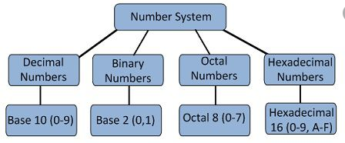
NUMBER SYSTEM
A number system defines how a number can be represented using distinct symbols. A number can be represented differently in differently in different systems.
For Example: the two numbers (2A)16 and (52)8 refers to same no (42)10 but their representation is different
Positional number system: 1. In positional number system, each symbol represents different value depending on the position they occupy in a number. 2. The total value of a positional number is the total of the resultant value of all positions. 3. Example: 12 can be 1 x 10¹ + 2 x 10⁰, 10 + 2 = 12

Slide 3
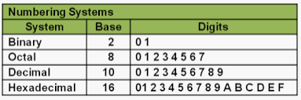
Non-Positional number system: 1. In non-positional number system, each symbol represents the same value regardless of its position. 2. Example: Roman number system where I for 1, II for 2 etc.
Three important characteristics of a number system having positional notation (place value, i.e., each digit position has a weight or a value associated):
Base/Radix is equal to the number of digits.
Suppose a number system has base N then number of symbols associated with it are N-1
each digit is multiplied by the radix raised to an appropriate power (depending on its position) to get its place value.

Slide 4
DECIMAL NUMBER SYSTEM
number system continued…
This is most generally used.
Consists of ten symbols 0,1,2, 3, 4, 5, 6, 7,8, 9
it’s a positional value system, i.e. place value of a digit depends upon its position.

Slide 5
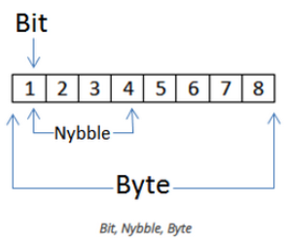
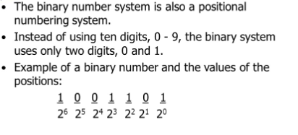
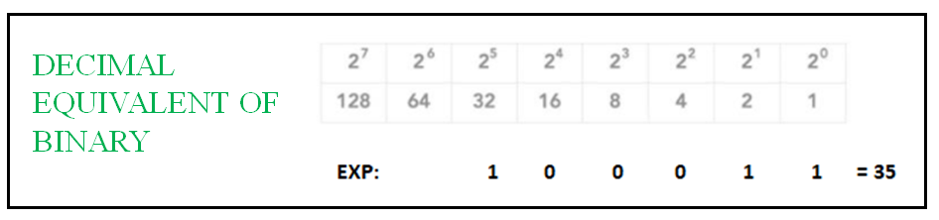
BINARY NUMBER SYSTEM
number system continued…
number system continued…

Slide 6
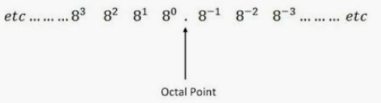
OCTAL NUMBER SYSTEM
number system continued…
Consists of eight digits/symbols: 0,1,2,3,4,5,6 and 7
it’s a positional value system, i.e. value of a digit depends upon its position.

Slide 7
HEXADECIMAL NUMBER SYSTEM
number system continued…
Consists of 16 digits and characters: 0,1,2,3,4,5,6,7,8,9,A,B,C,D,E,F.
it’s a positional value system, i.e. value of a digit depends upon its position.
Also called Alpha-numeric number system.

Slide 8
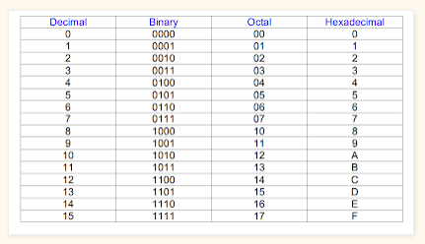
Human are accustomed to DECIMAL and digital circuits uses BINARY then what is the need of OCTAL and HEXADECIMAL
Binary numbers can be long with a lot of Bits.
Longer numbers create Confusion and in coping there is chance of error
Octal represent binary in 1/3 and hexadecimal in 1/4 number of digits.
All number system together

Slide 9
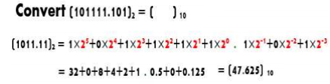
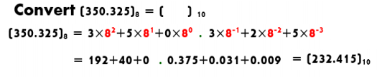
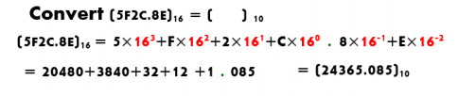
OTHERS TO DECIMAL
(repeated multiplication of digit with corresponding weight)
Binary to Decimal
OCTAL TO DECIMAL
HEXADECIMAL TO DECIMAL

Slide 10
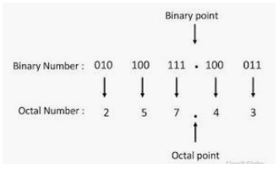
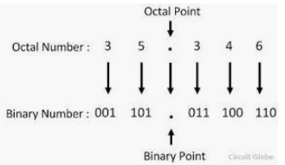
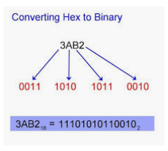
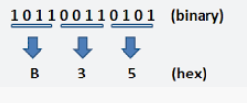
BINARY TO OCTAL OCTAL TO BINARY
(pair in group of 3 bits and write equivalent decimal ) (for each digit write 3 bits binary equivalent)
BINARY TO HEXADECIMAL HEXADECIMAL TO BINARY
(pair in group of 4 bits and write equivalent decimal ) (for each digit write 4 bits binary equivalent)

Slide 11
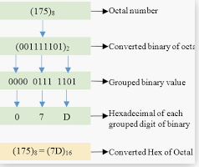
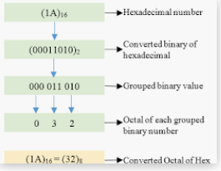
OCTAL TO HEXADECIMAL HEXADECIMAL TO OCTAL
First convert into binary then into hexa First convert into binary then into OCTAL

Slide 12
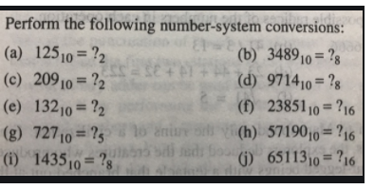
Practice Questions

Slide 13
Representation of Negative no.s
Signed magnitude representation- extra sign bit is added to number
0 for positive no and 1 for negative no
Ex 0 101001 =+41
1 101001 = -41
2) Compliment representation
1’s compliment
2’s compliment
0111 = +7
1000 = -7 1’s complement representation
1001 = -7 2’s complement representation

Slide 14
Subtraction Using Compliments
Complements are used in digital computers for simplifying the subtraction operation (hardware requirement will be lesser) and for logical manipulation. There are two types of complements for each base-r system:
• RADIX COMPLEMENT (or R’s Complement)
• DIMINISHED RADIX COMPLEMENT (or (R-1)’s complement).
– Also, it could be the 2’s and 1’s complement for the
binary system.
– And, 10’s and 9’s complement for decimal numbers.

Slide 15
DIMINISHED RADIX COMPLEMENT
– Given a number N in base r having n digits, the (r-1)’s complement of N is defined as (r^{n} – 1) – N.
– For decimal numbers, r = 10 and r – 1 = 9, so the 9’s complement of N is (10^{n} – 1) – N.
10^{n} represents a number that consists of a single 1 followed by n 0’s.
10^{n} – 1 is a number represented by n 9’s.
For example, if n=4, we have 10⁴ = 10,000 and 104 -1 = 9999
9’s complement of a decimal number is obtained by subtracting each digit from 9.
–Example:
• The 9’s complement of 546700 is 999999 –546700 = 453299
• The 9’s complement of 012398 is 999999 –012398 = 987601

Slide 16
For binary numbers, r = 2 and r – 1 = 1, so the 1’s complement of N is (2^{n}– 1) –N.
For example, if n = 4, we have 2⁴ = (10,000)2 and 2⁴ – 1 = (1111)2.
• Thus the 1’s complement of a binary number is obtained by subtracting each digit from 1.
• Therefore, the 1’s complement of a binary number is formed by changing 1’s to 0’s and 0’s to 1’s.
Example: 111100 =000011

Slide 17
RADIX Complement
The r’s complement of an n-digit number N in base r is defined as r^{n} – N
The r’s complement is obtained by adding 1 to the (r – 1)’s complement since r^{n} – N = [(r^{n} – 1) – N] + 1.
Example (Decimal)
10’s complement of 012398 is 987602.
10’s complement of 246700 is 753300.
Example for BINARY:
• The 2’s complement of 1101100 is 0010100.
• The 2’s complement of 0110111 is 1001001.

Slide 18
SUBTRACTION WITH COMPLEMENTS
The subtraction of two n-digit unsigned numbers M – N in base r can be done as follows:
Add the minuend M to the r’s complement of the subtrahend.(M+(-N))
2. If M > N, the sum will produce an end carry, which is discarded; what is left is the result M – N.
3. If M < N, the sum does not produce an end carry then the result is in r’s
complemented form. To obtain the answer in familiar form, take the r’s complement
of the sum and place a negative sign in front.

Slide 19
Example 1: Using 10’s complement, subtract,72532 – 3250.
M = 72532
10’s complement of N = + 96750
Sum = 169282
Discard the end carry
ANSWER = 69282
Example 2: Using 10’s complement, subtract 3250 - 72532.
M = 03250
10’s complement of N = + 27468
Sum = 30718
There is no end carry.
Answer - (10’s complement of 30718) = -69282
NOTE that since 3250 < 72532, the result is negative.

Slide 20
Example 1: Given the two binary numbers X = 1010100 and Y = 1000011, perform the subtraction (a) X – Y
and (b) Y – X using 2’s complements
.
(a) X = 1010100
2’s complement of Y = + 0111101
Sum = 10010001
Discard the end carry
Answer: X – Y = 0010001
Y = 1000011
2’s complement of X = + 0101100
Sum = 1101111
There is no end carry.
Answer: Y- X = -(2’s complement of 1101111) = -0010001
****Subtraction of unsigned numbers can be done also by means of the (r-1)’s complement.

Slide 21
BINARY CODES
How to represent characters, colors, etc?
Assign a unique binary code to each element of the set.
Given n bits, a binary code is a mapping from the set of elements to a subset of the 2^{n} binary numbers.

Slide 22
Suppose we want to code 7 colors of the rainbow
As a minimum, we need 3 bits to define 7 unique values
3 bits define 8 possible combinations
Only 7 combinations are needed
Code 111 is not used
Other assignments are also possible
Color | 3-bit code
Red | 000
Orange | 001
Yellow | 010
Green | 011
Blue | 100
Indigo | 101
Violet | 110

Slide 23
BCD CODES
Binary number system is most natural for computers
But people are used to the decimal system
Must convert decimal numbers to binary, do arithmetic on binary numbers, then convert back to decimal
To simplify conversions, decimal codes can be used
Define a binary code for each decimal digit
Since 10 decimal digits exist, a 4-bit code is used
But a 4-bit code gives 16 unique combinations
10 combinations are used and 6 will be unused

Slide 24
BCD CODE
Simplest binary code for decimal digits
Only encodes ten digits from 0 to 9
BCD is a weighted code
The weights are 8,4,2,1
There are six invalid code words
1010, 1011, 1100, 1101, 1110, 1111
Example on BCD coding:
13 ⇔ (0001 0011)_{BCD}
Decimal | BCD
0 | 0000
1 | 0001
2 | 0010
3 | 0011
4 | 0100
5 | 0101
6 | 0110
7 | 0111
8 | 1000
9 | 1001

Slide 25
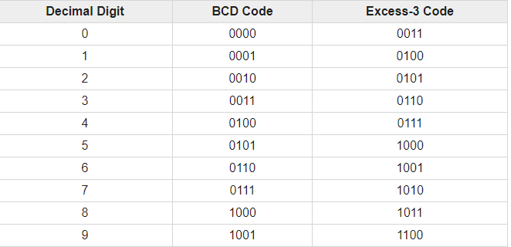
EXCESS-3 CODES
The excess-3 code (or XS3) is a non-weighted code
Can be obtained by adding 3 to the each 4-bit group in BCD representation
It is a self-complementary binary coded decimal (BCD) code .
it means 9’s compliment of decimal number can be obtained by
taking 1’s compliment
For ex- BCD NO-395
Excess three representation 0110 1100 1000
9‘s compliment of no is 604
Excess three representation 1001 0011 0111

Slide 26
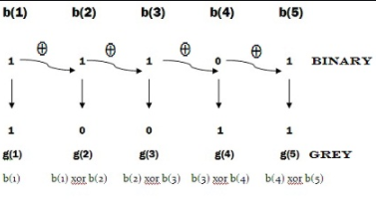
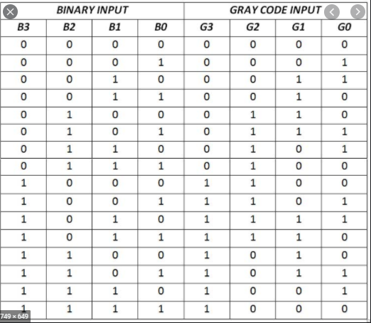
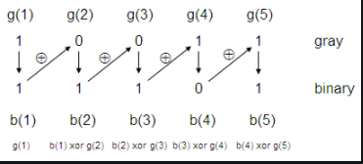
BINARY TO GREY
GREY TO BINARY

Slide 27
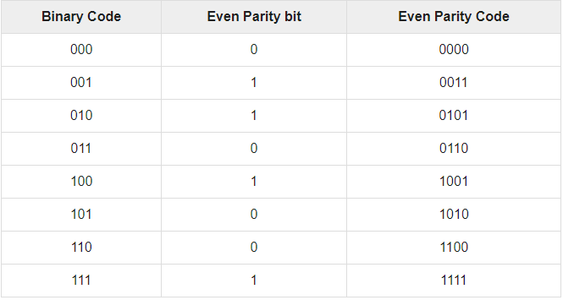
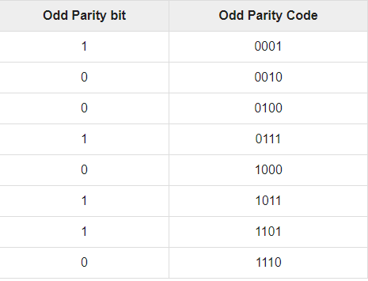
ERROR DETECTING CODES-Parity
during transmission of binary data from one system to the other, the noise may also be added. Due to this, there may be errors in the received data at other system. That means a bit 0 may change to 1 or a bit 1 may change to 0. We can’t avoid the interference of noise. But, we can get back the original data first by detecting whether any errors present and then correcting those errors.
It is easy to include add one parity bit either to the left of MSB or to the right of LSB of original bit stream. There are two types of parity codes, namely even parity code and odd parity

Slide 28
Extended Binary Coded Decimal Interchange Code (EBCDIC)
Extended binary coded decimal interchange code (EBCDIC) is an 8-bit binary code for numeric and alphanumeric characters.
It was developed and widely used by IBM midrange and mainframe computers.
It is a coding representation in which symbols, letters and numbers are presented in binary language.
This encoding was developed in 1963 and 1964. EBCDIC was developed to enhance the existing capabilities of binary-coded decimal code.

